Slide 1
Business Process Engineering
Sobia.Iftikhar@nu.edu.pk Week 05

Slide 2
Control Flow Patterns
Control flow patterns provide a bench mark/scale for expressing process orchestrations.
Control flow patterns are independent of concrete process languages, so that each pattern can be expressed in different process languages.
Control flow patterns can also be used to compare the expressiveness of process languages.

Slide 3
control flow patterns
Basic control flow patterns include
sequence,
and split,
and join,
exclusive or split
exclusive or join

Slide 4
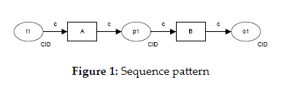
Sequence Control Flow Pattern
A task in a process in enabled after the completion of a preceding task in the same process.
The Sequence pattern serves as the fundamental building block for processes. It is used to construct a series of consecutive tasks which execute in turn one after the other
Example: Sequential routing, serial routing.

Slide 5
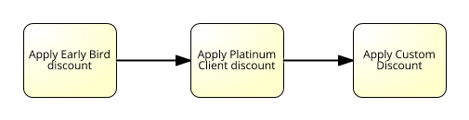
Real Time Example:
The verify-account task executes after the credit card details have been captured.
A receipt is printed after the train ticket is issued.
There is one context condition associated with this pattern: an instance of the Sequence pattern cannot be started again until it has completed execution of the preceding thread of control

Slide 6
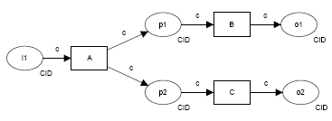
Parallel split/ and split
In a parallel split we are referring to a point in a workflow process where a single thread of control split into multiple threads of control.
And split or parallel split is a point in a process model where a single thread of control splits into multiple threads of control which are executed concurrently.
AND-split, parallel routing, parallel split, fork.

Slide 7
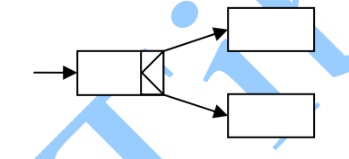
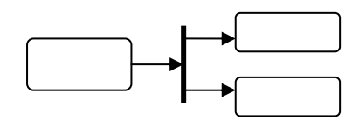
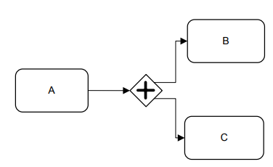
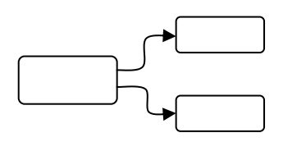
Example
After completion of the capture enrolment task, run the create student profile and issue enrolment confirmation tasks simultaneously.
Once the customer has paid for the goods, pack them and issue a receipt.

Slide 8
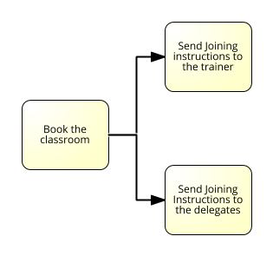
Example

Slide 9
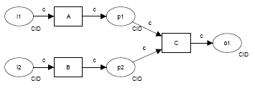
Synchronization/ And Join

Slide 10
Example
Cash-drawer reconciliation can only occur when the store has been closed and the credit card summary has been printed.
The despatch-goods task runs immediately after both the check-invoice and produce-invoice tasks are completed.

Slide 11
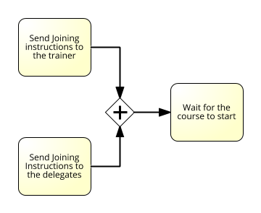
Example

Slide 12
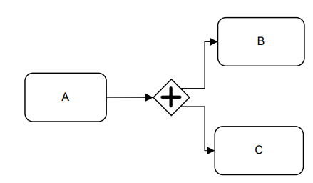
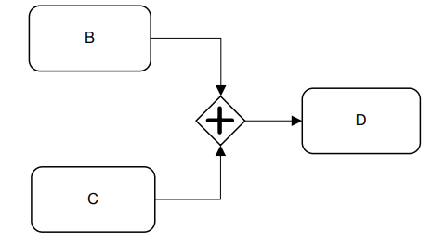
Process Orchestration
And Split
And Join

Slide 13
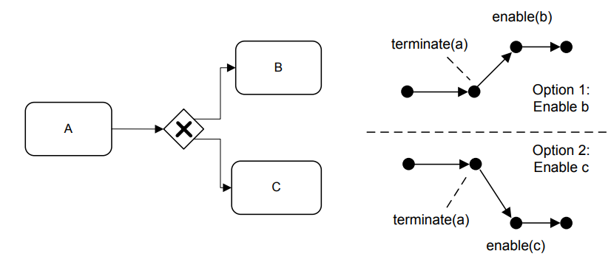
Xor Split/exclusive
Xor Join

Slide 14
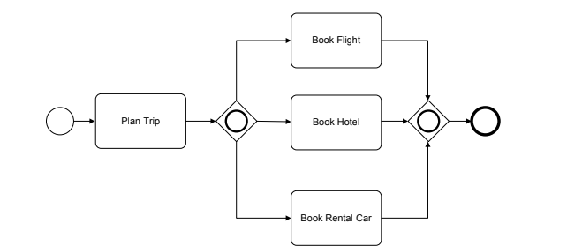
Or Gate
or gateway enables multiple activities of type
receive. If the first of these activities receives a message, the other activities
are neglected. As a result, a deferred choice pattern is realized.

